Slide 2
Cloud survival guide for the traditional IT admins
Vladimir Stefanovic
Microsoft Azure MVP
Cloud Solution Architect @SuperAdmins

Slide 3

Who am I
vladimir@Azure:~$ az speaker show
{
"speakerName": "Vladimir Stefanovic",
"location": "Belgrade, Serbia",
"titles": "Microsoft Azure MVP, MCT Regional Lead",
"position": "Cloud Solution Architect @SuperAdmins",
"twitter": "@wladinho31"
}

Slide 4
Agenda
What is the difference between traditional and cloud admins?
What skills I have to improve to make the transition smooth?
What IaC is? Is that necessary? Am I a developer now?
Continuous learning

Slide 5
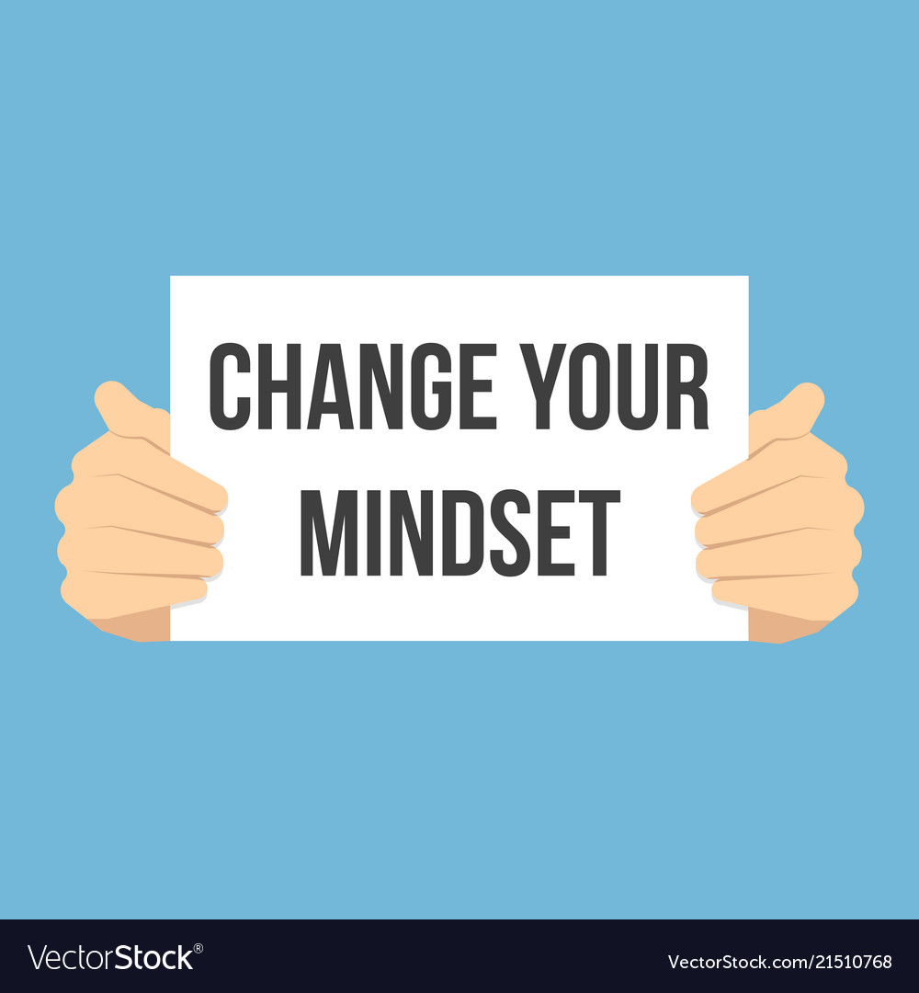

Slide 6
What is the difference between traditional and cloud admins?
IT admin responsibility
Physical networking
Hardware maintenance
Storage administration
Deploying VMs
Upgrading hypervisors
Patching hardware and OS
…
Cloud admin responsibility
Logical networking
Deploying infrastructure
Developing IaC templates and scripts
Deployment and configuration automation
Monitoring resources and cloud costs
…

Slide 7
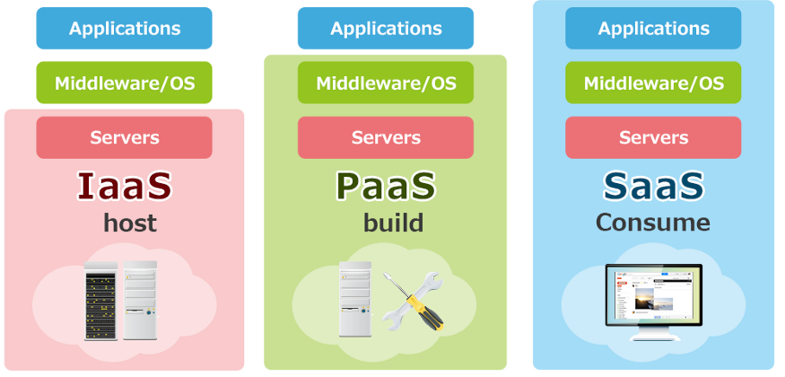

What skills I have to improve to make the transition smooth?
General understanding of cloud models
IaaS vs. PaaS vs. SaaS

Slide 8
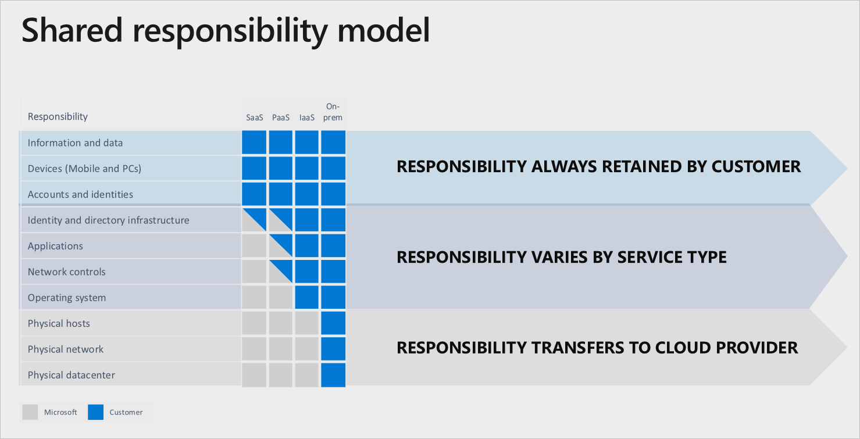
What skills I have to improve to make the transition smooth?
Automation skills
PowerShell, DSC, Bash…
ARM, Terraform, Ansible…

Slide 9
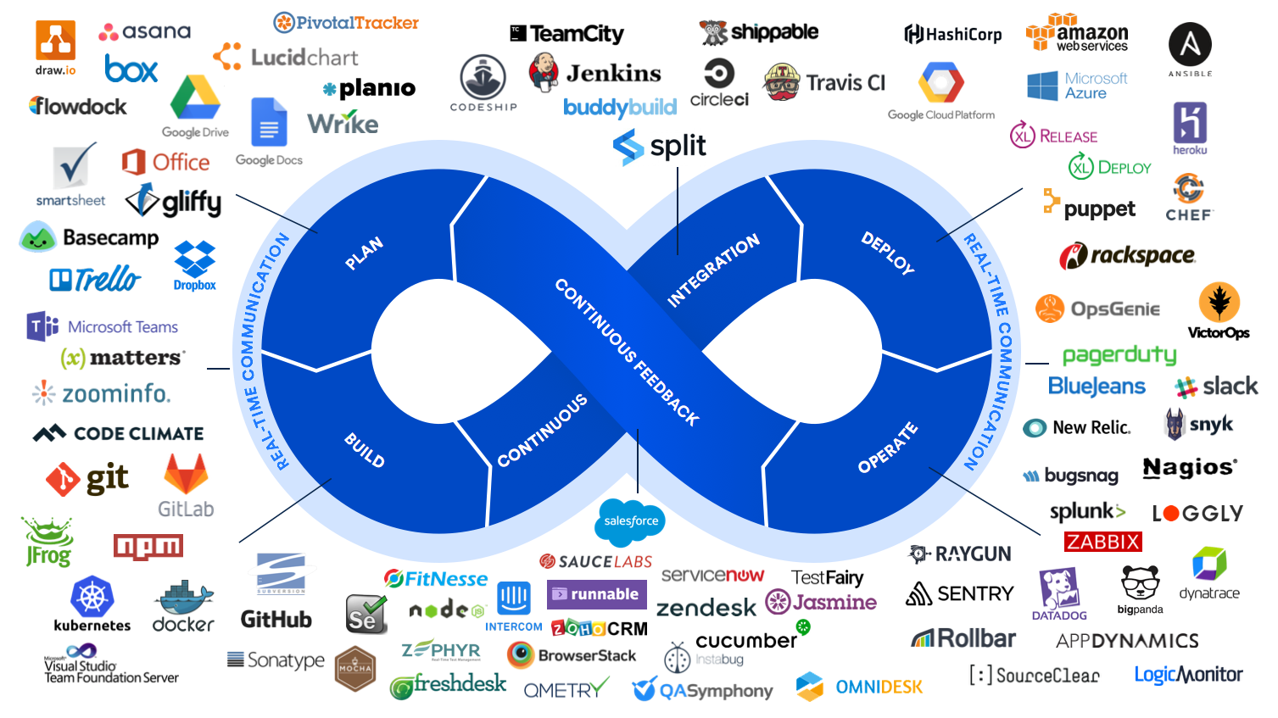
What skills I have to improve to make the transition smooth?
Security concepts
RBAC, NSG, Governance, Policy…

Slide 10
What skills I have to improve to make the transition smooth?
DevOps concepts and tools

Slide 11
What skills I have to improve to make the transition smooth?
General understanding of cloud models
IaaS vs. PaaS vs. SaaS
Automation skills
PowerShell, DSC, Bash…
ARM, Terraform, Ansible…
Security concepts
RBAC, NSG, Governance, Policy…
DevOps concepts and tools

Slide 12
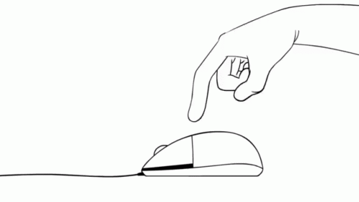
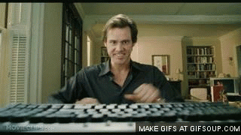
What IaC is? Is that necessary? Am I a developer now?
The answer is so simple. Yes. That is necessary
Manual actions should be part of history …
Automate deployment and configuration as much as possible

Slide 13
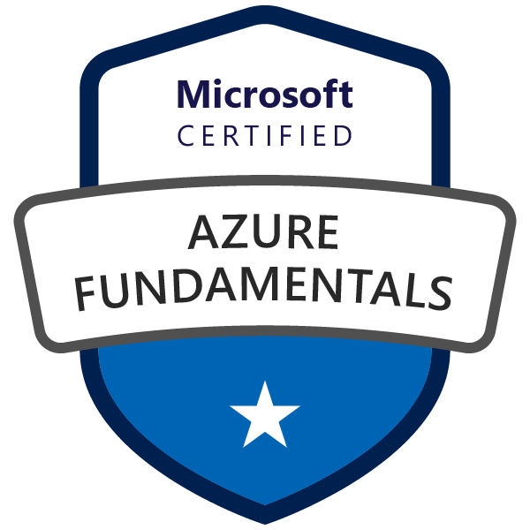
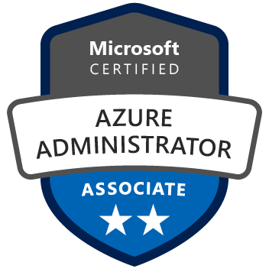

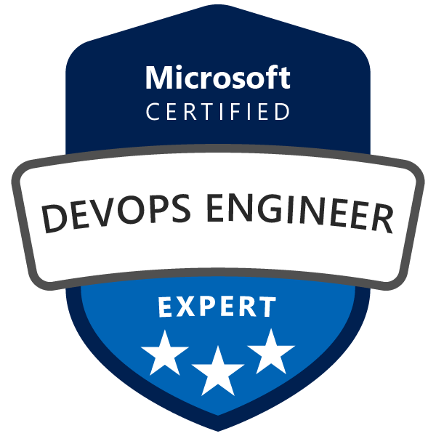

Continuous learning

Slide 14
Continuous learning

Slide 15
Demo
Demo 1 – Deploy an application in a cloud-native manner
Demo 2 – Manual vs. Automated deployment

Slide 16


Slide 17
Thank you for your attendance

